Slide 1
Storage Devices
Instructor: Saba Iqbal

Slide 2
Learning Objectives
Secondary storage devices and their need
Classification of commonly used secondary storage devices
Difference between sequential and direct access storage devices
Basic principles of operation, types, and uses of popular secondary storage devices such as magnetic tape and magnetic disk

Slide 3
Limitations of Primary Storage
Limited capacity because the cost per bit of storage is high
Volatile - data stored in it is lost when the electric power is turned off or interrupted

Slide 4
Secondary Storage Device
A storage device is a computer hardware component that writes and reads data to and from storage media.
Storage devices are also called secondary storage devices, auxiliary storage devices, or backing storage devices
Used in a computer system to overcome the limitations of primary storage
Has virtually unlimited capacity because the cost per bit of storage is very low
Has an operating speed far slower than that of the primary storage
Used to store large volumes of data on a permanent basis

Slide 5
Function of secondary storage devices
A storage device performs two functions.
These are writing and reading to and from the storage media
Writing data means recording data from memory to a storage medium
Reading and retrieving data means transferring data from storage medium into the computer’s memory for use by the operating system or application programs

Slide 6
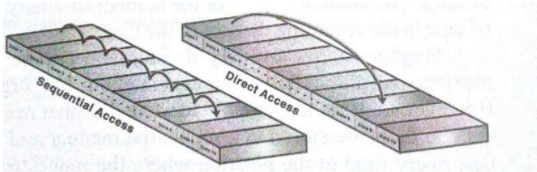
Types of secondary storage devices
There are to methods of accessing data from secondary storage devices
Sequential access
Direct access

Slide 7
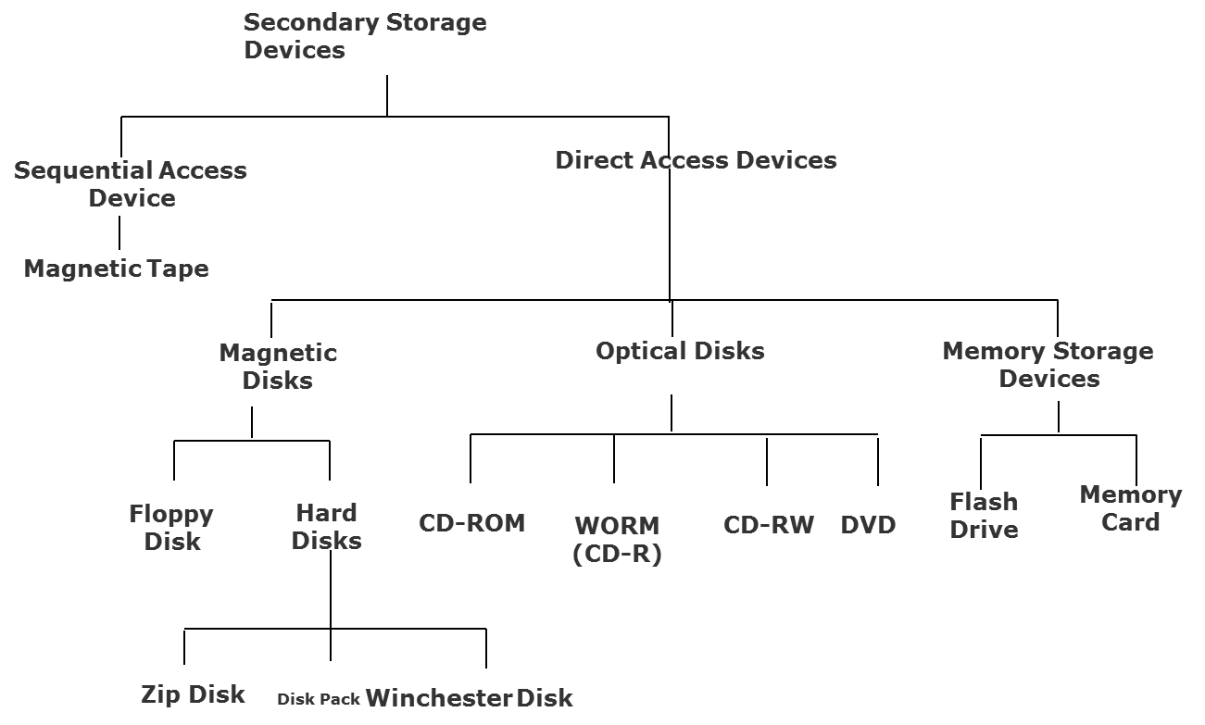
Classification of Commonly Used Secondary Storage Devices

Slide 8
Sequential-access Storage Devices
Arrival at the desired storage location may be preceded by sequencing through other locations
Data can only be retrieved in the same sequence in which it is stored
Access time varies according to the storage location of the information being accessed
Suitable for sequential processing applications where most, if not all, of the data records need to be processed one after another
Magnetic tape is a typical example of such a storage device

Slide 9
Direct-access Storage Devices
Devices where any storage location may be selected and accessed at random
Permits access to individual information in a more direct or immediate manner
Approximately equal access time is required for accessing information from any storage location
Suitable for direct processing applications such as on- line ticket booking systems, on-line banking systems
Magnetic and optical disks are typical examples of such a storage device

